Slide 1
MATLAB 程式設計進階篇
Matrix Notations
張智星 (Roger Jang)
jang@mirlab.org
http://mirlab.org/jang
清大資工系 多媒體檢索實驗室

Slide 2
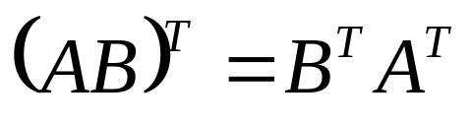
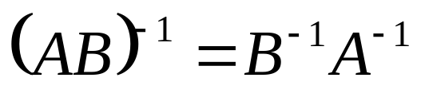
Transpose and Inverse
A property of Matrix transpose
A property of matrix inverse

Slide 3
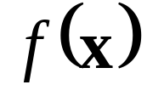
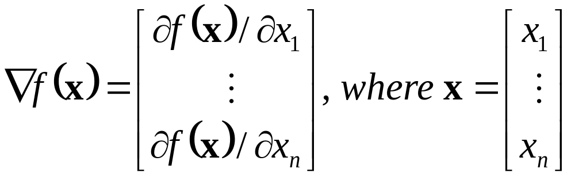
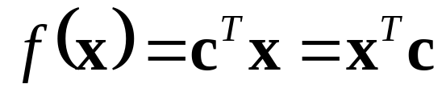
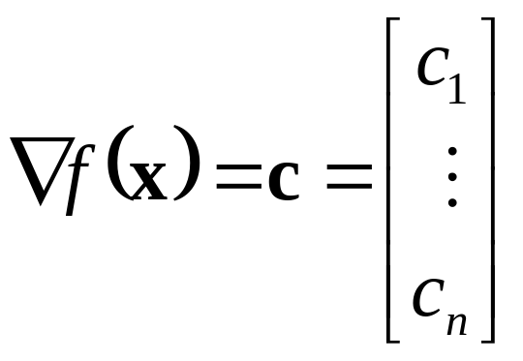
Gradient of a Function
Gradient of a function
If

Slide 4

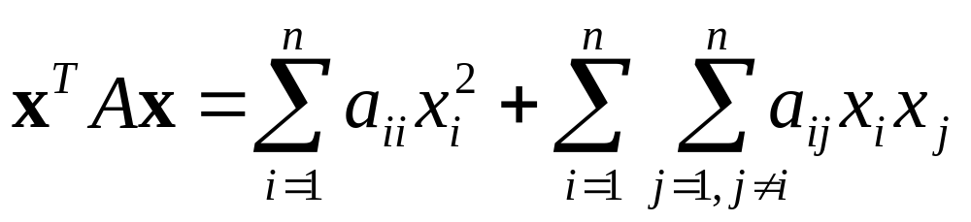
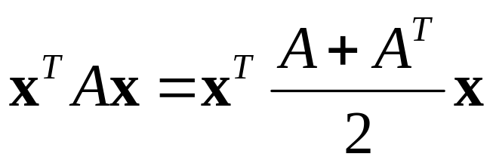
Quadratic Form
Quadratic form of
A can be assumed symmetric since

Slide 5
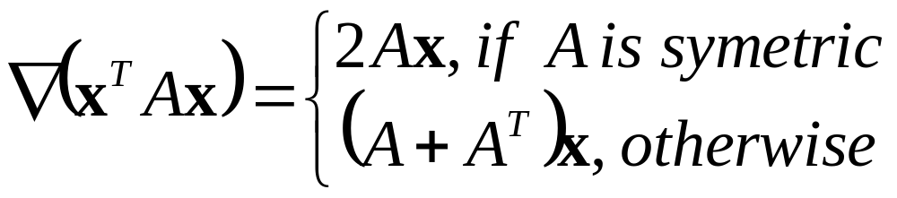
Gradient of a Quadratic Form
The gradient of a quadratic form

Slide 6
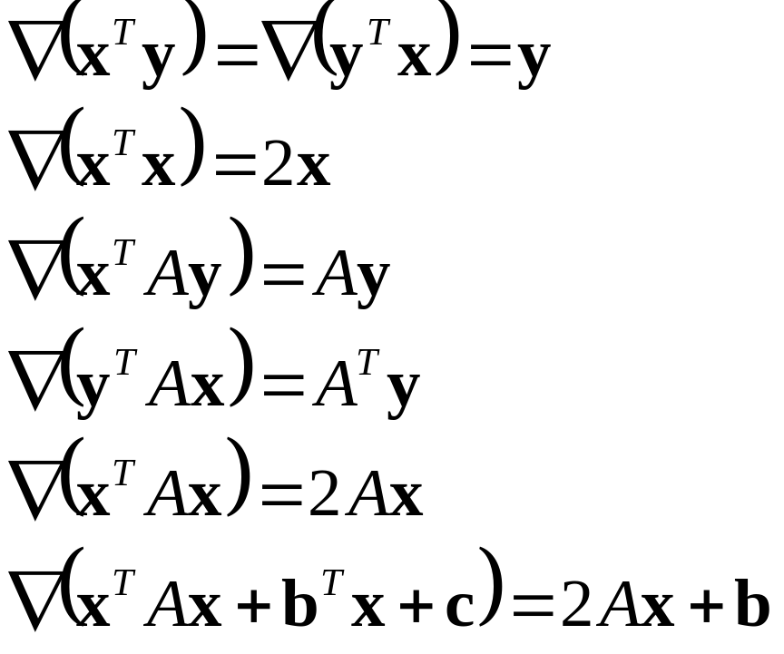

Common Formulas
Some common formulas

